Slide 1
UCAS 2027 entry
Mark Simon UCAS coordinator
Anne Cheshire Head of Sixth-form

Slide 2
This session will cover
A summary of the support, guidance and advice that has been shared with students
An overall summary of the process
Next steps to take as a family
parent-guide-2027.pdf

Slide 3
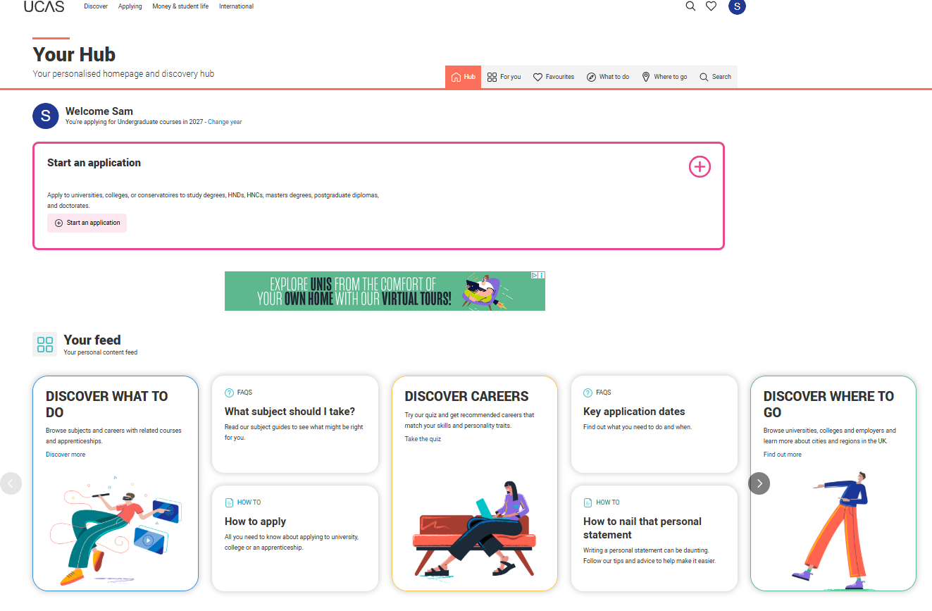
Public
Notes:
Students have been told to set up their UCAS hub
74 out of 193 have done so far…

Slide 4
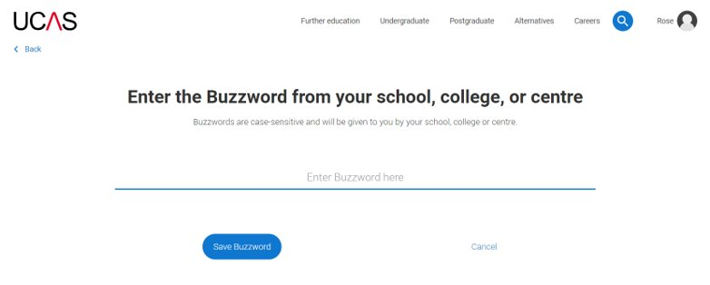
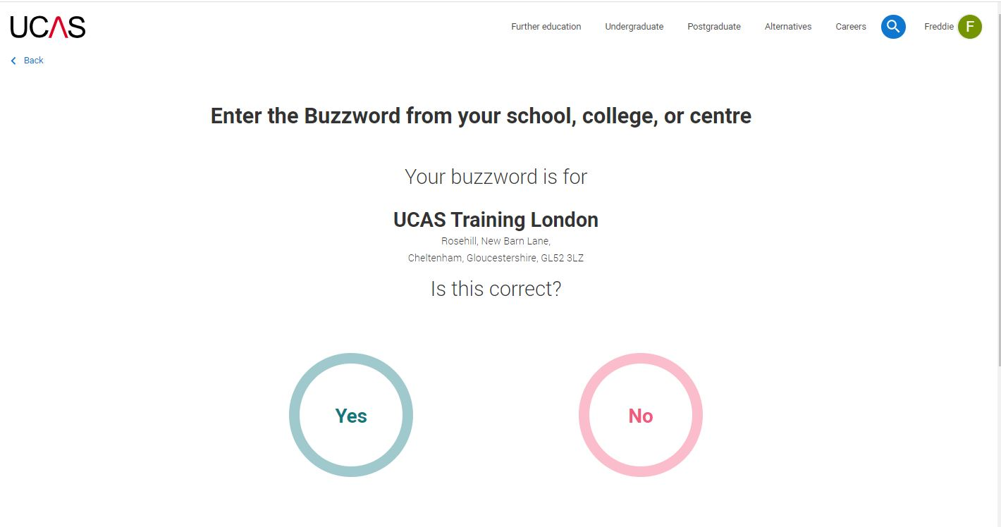

Linking to your school, college or centre
Enter the buzzword, and confirm the details are correct.
This will link your application to your school or college, so they can track your progress and provide support, including adding your reference.
Our buzzword for this year is
‘dragon’
Public

Slide 5
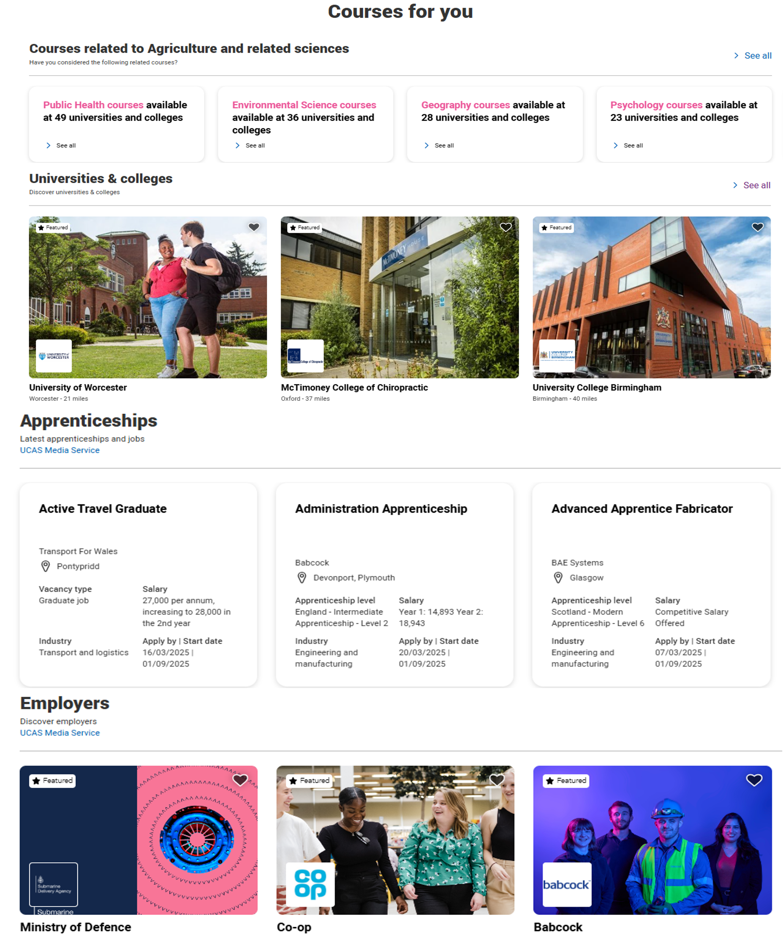
Options side by side
Compare all your options side-by-side. Take a closer look at apprenticeships, courses, and job opportunities - all in one place.
Build your personalised UCAS Hub profile and find your best fit!
Public
Notes:
Use our information on careers, apprenticeships and university to explore what routes are available and which one is right for you.

Slide 6
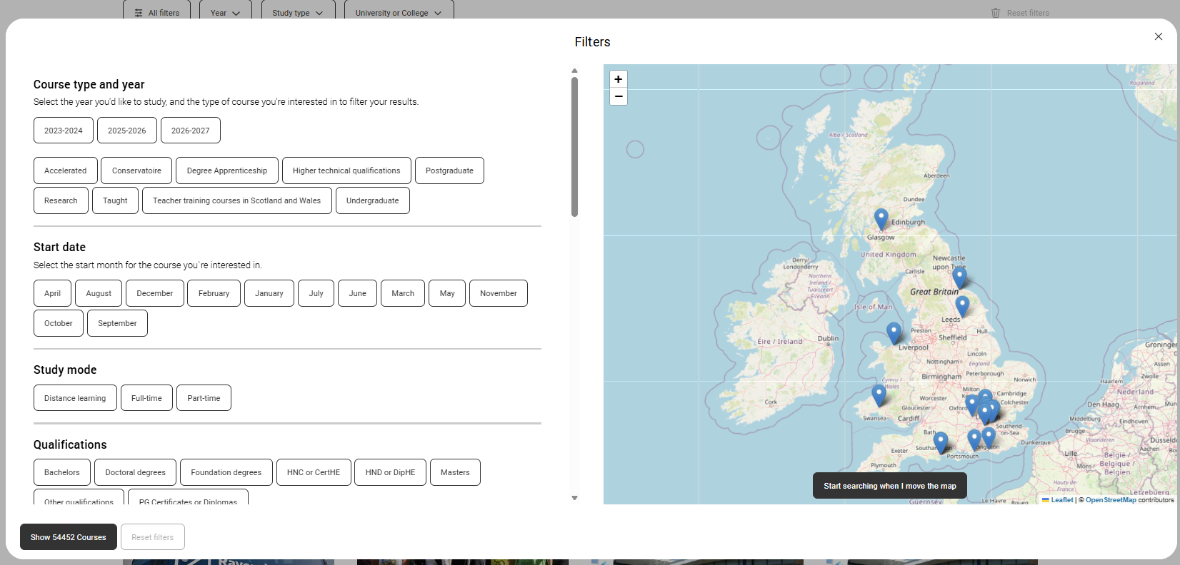
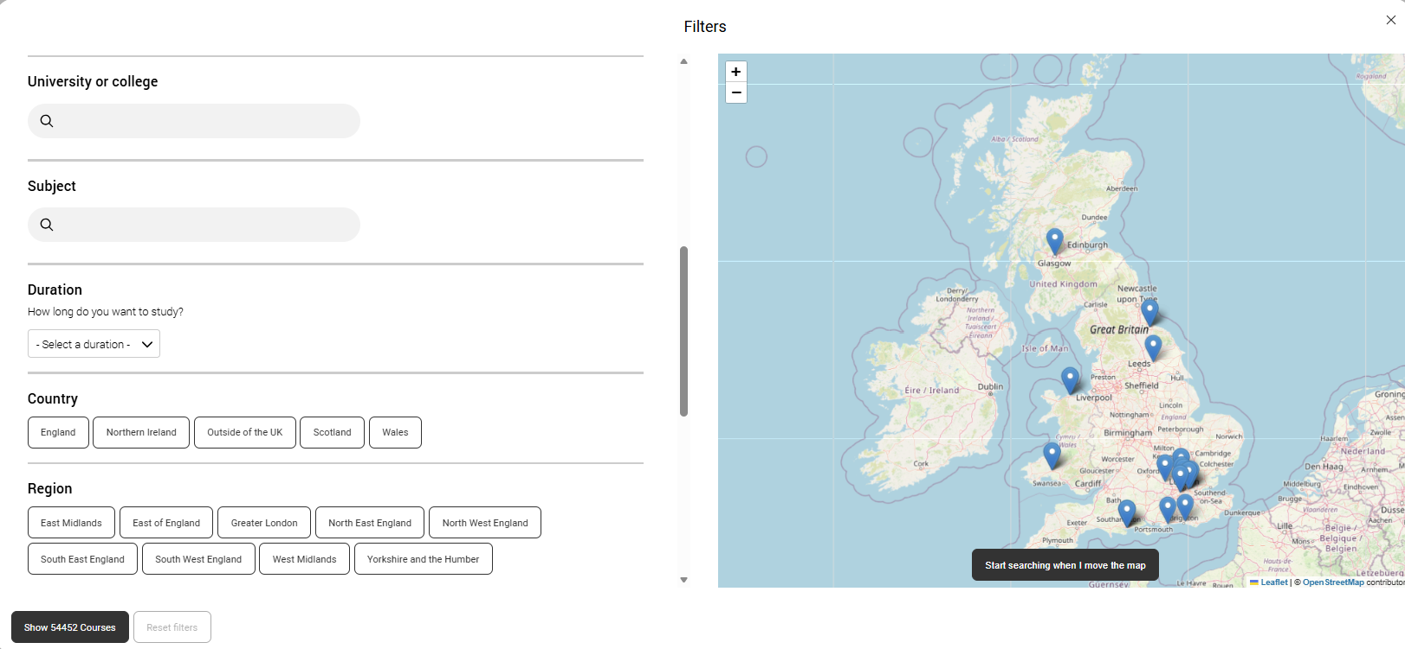
UCAS Course SEARCH
Top Tips for Using the UCAS Search Tool
Explore broadly first to avoid missing great courses you may not have considered.
Use filters to refine results by year, study type, or university/college.
Sort results in the way that works best for you, such as alphabetically or in a way that helps you compare courses.
Check course details (entry requirements, placement options, study modes) to see how well they match what you want.
Favourite courses you like so you can easily return to them later; save time and keeps everything organised.
Public

Slide 7
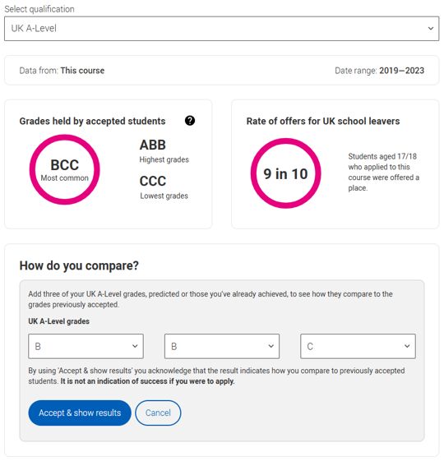
The course matters
Teaching & learning
Teaching hours, self-study, lectures, and group work.
Assessment & structure
Coursework, exams, practical work, and module choices.
Entry requirements
Grades, skills, interviews, or auditions.
Career links
Placements, internships and study abroad.
Class size & experience
Student numbers and learning environment
Public
Notes:
How many teaching hours vs. self-directed study does the course have?
How many lectures are there, and how much group work will be done in seminars?
How is the course assessed (e.g. coursework, exams, practicals, presentations, group work)?
How many students will be on the course?
What grades do you need to get on the course?
What qualities or experience do they look for in an applicant?
Will you need to attend an interview or audition?
What modules are compulsory and optional – are there any work placements or years abroad? Look carefully at the core course content, and the range of optional studies/modules available.
What links does the course/department have with employers?
Which modules are the most interesting and relevant to your career aspirations?
Does the course or university/college research, any internship, placement, or study abroad opportunities?
The UCAS course search is a great place to start your research, and you can access the historical entry grades tool.
Universities and colleges set their own entry requirements for higher education courses, and these vary widely depending on the subject, the specific course, and the course provider. They set the entry requirements for each course to ensure you have the right skills and knowledge to successfully complete the course. You can see grade profiles of students previously accepted, and offer rates for the course, under the entry requirements in the UCAS search tool.
Find out more online at:
https:// www.ucas.com/applying/you-apply/what-and-where-study/entry-requirements.
https://www.ucas.com/applying/before-you-apply/what-and-where-to-study/entry-requirements/understanding-historical-entry

Slide 8

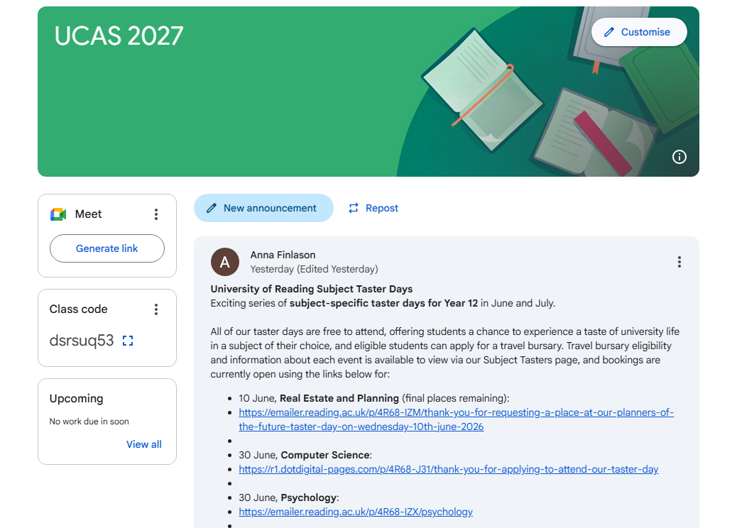
Code: dsrsuq53
There are 193 of you! (177 joined so far)
Information here all the time

Slide 9
Support, guidance and advice
Numerous opportunities posted in the GC page
Students have had the process explained to them, twice in Y12, including personal statements open days, a brief summary of student finance, how to book accommodation
The have been given a virtual tour of the functions for researching courses using the UCAS hub
They have had a step-by-step guide to completing the application shared with them
They now have the buzzword and are ready to start completing and further researching their application before the Predicted Grades are published in September

Slide 10
Timeline for 2027 entry
Date | UCAS process for 2025 entry
NOW | Register on UCAS hub
28th April | UCAS 2026 courses in search tool
12th May | UCAS 2025 system live (not for MES students)
11th May | MES UCAS The process explained
2nd July | MES UCAS Application launch assembly
15th July | MES personal statements assembly
14th July | MES UCAS Parents Information Evening - 6.00pm
17th July | Future Pathways day - Personal Statement session
18th Sept | UCAS predicted grades to be published from this date
1st October | MES Early Entry deadline
15th October 18:00 | UCAS Early Entry deadline
4th January 2026 | MES UCAS deadline
13th January 2026 | UCAS Equal Consideration deadline
| 10

Slide 11
Overall summary of the process
Students shortlist potential courses using UCAS hub
Students complete all sections of the application, including the personal statement
School shares predicted grades from September 18th
Students apply by 1st Oct – early entrants; or 4th Jan – everyone else
Once submitted, school adds Predicted Grades and references and then sends to UCAS

Slide 12
Eligibility criteria
University courses will normally include an offer based on 3 A-levels.
(BTECs are equivalent Level 3 courses)
Some universities use tariff points – but many do not.
Other evidence such as GCSEs, external tests, personal statement, work experience and references are considered in order to make an offer decision. Interviews are also used for some competitive courses.
Students will likely receive a conditional offer that will be confirmed on results day
Notes:
UCAT – Universities Clinical Aptitude Test
LNAT – Law National Aptitude Test
MLAT – Modern Languages Admissions Test
TSA – Thinking Skills Assessment
HAT – History Aptitude Test
PAT – Physics Aptitude Test
TMUA – Test for Mathematics for University Admission
OLAT – Oriental Languages Aptitude Test
ELAT – English Literature Admissions Test

Slide 13
The course matters
Teaching & learning
Teaching hours, self-study, lectures, and group work.
Assessment & structure
Coursework, exams, practical work, and module choices.
Entry requirements
Grades, skills, interviews, or auditions.
Career links
Placements, internships and study abroad.
Class size & experience
Student numbers and learning environment
Public
Notes:
How many teaching hours vs. self-directed study does the course have?
How many lectures are there, and how much group work will be done in seminars?
How is the course assessed (e.g. coursework, exams, practicals, presentations, group work)?
How many students will be on the course?
What grades do you need to get on the course?
What qualities or experience do they look for in an applicant?
Will you need to attend an interview or audition?
What modules are compulsory and optional – are there any work placements or years abroad? Look carefully at the core course content, and the range of optional studies/modules available.
What links does the course/department have with employers?
Which modules are the most interesting and relevant to your career aspirations?
Does the course or university/college research, any internship, placement, or study abroad opportunities?
The UCAS course search is a great place to start your research, and you can access the historical entry grades tool.
Universities and colleges set their own entry requirements for higher education courses, and these vary widely depending on the subject, the specific course, and the course provider. They set the entry requirements for each course to ensure you have the right skills and knowledge to successfully complete the course. You can see grade profiles of students previously accepted, and offer rates for the course, under the entry requirements in the UCAS search tool.
Find out more online at:
https:// www.ucas.com/applying/you-apply/what-and-where-study/entry-requirements.
https://www.ucas.com/applying/before-you-apply/what-and-where-to-study/entry-requirements/understanding-historical-entry

Slide 14
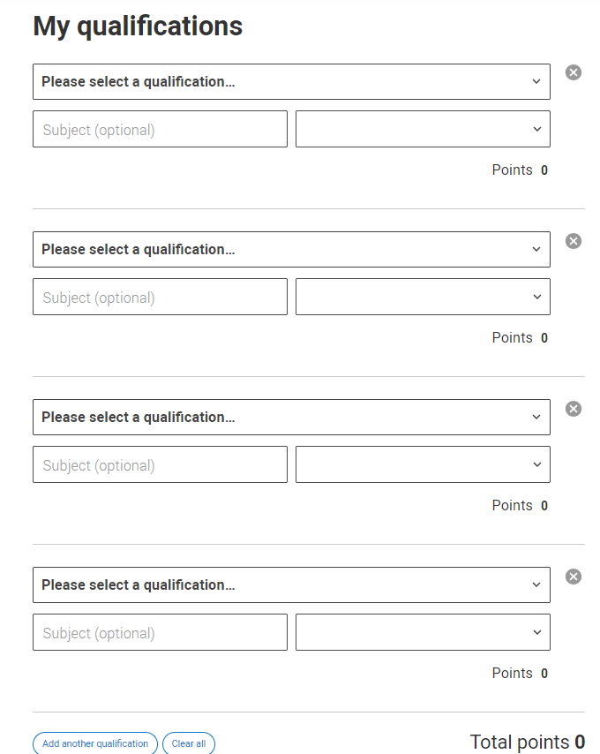
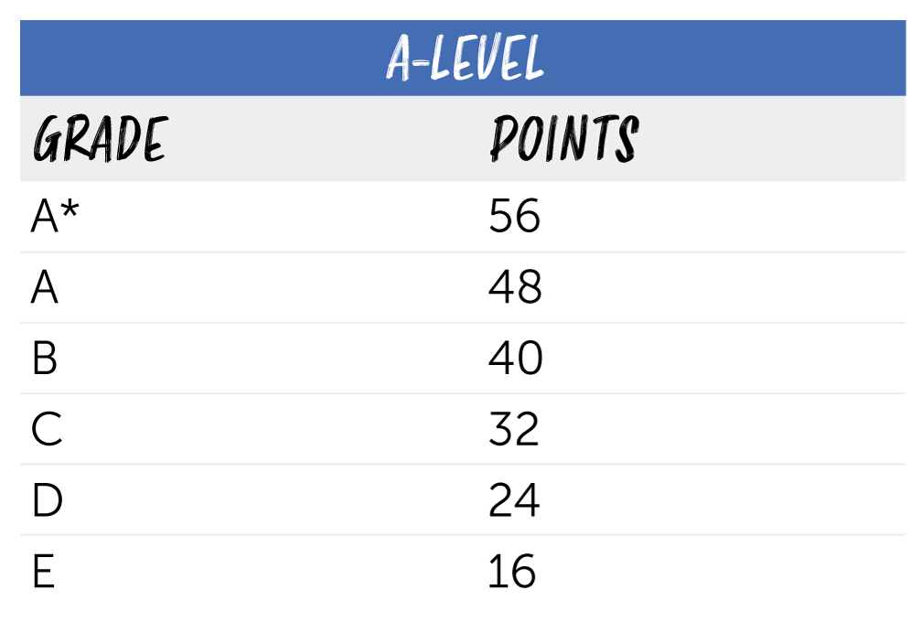
Predicted grades and references

Slide 15
Predicted grades and references
Predicted grades will be published from Friday 18th September.
Once finalised, Predicted Grades do not change.
Subject and tutor references will also be finalised at this point.

Slide 16
Predicted grades and references – 2025 data
87% of our Predicted Grades were accurate or over predicted
(5% were out by one grade, 8% out by two grades)
44% of all students had their Predicted grades correct with a margin of one grade compared to a 35% sector wide average.

Slide 17
Predicted grades and references – 2026 data
(Total number of students 228)
210 applications – (including 16 past students) – so 194 applications in total 84%
Of 10 FSM students, 9 applied and they were all offered a place (5 of which were at Russell Group unis)
152 were offered places at Russell Group universities – 78% of applicants – 68% of all students
3 Oxford, 2 Cambridge
4 medics (two former students); 0 vets; 0 dentists

Slide 18
Applications
The Russell Group
Early Entry
University of Birmingham
University of Bristol
University of Cambridge
Cardiff University
University of Durham
University of Edinburgh
University of Exeter
University of Glasgow
Imperial College London
King's College London
University of Leeds
University of Liverpool
London School of Economics & Political Science
University of Manchester
Newcastle University
University of Nottingham
University of Oxford
Queen Mary University of London
Queen's University Belfast
University of Sheffield
University of Southampton
University College London
University of Warwick
University of York
Oxbridge
Medicine
Dentistry
Veterinary Science
Conservatoires
Types
Campus
City
Home / far
Medicine, Veterinary Science, Dentistry, Oxbridge, Conservatoires
Notes:
Bath, St Andrews, Lancaster are highly esteemed institutions that are non-members

Slide 19

Open days
Email in advance for absence to be authorised – advised to sign-up for subject talks in advance
mesYear12@maidenerleghtrust.org
mesAttendance@maidenerleghtrust.org
Medicine, Veterinary Science, Dentistry, Oxbridge, Conservatoires

Slide 20
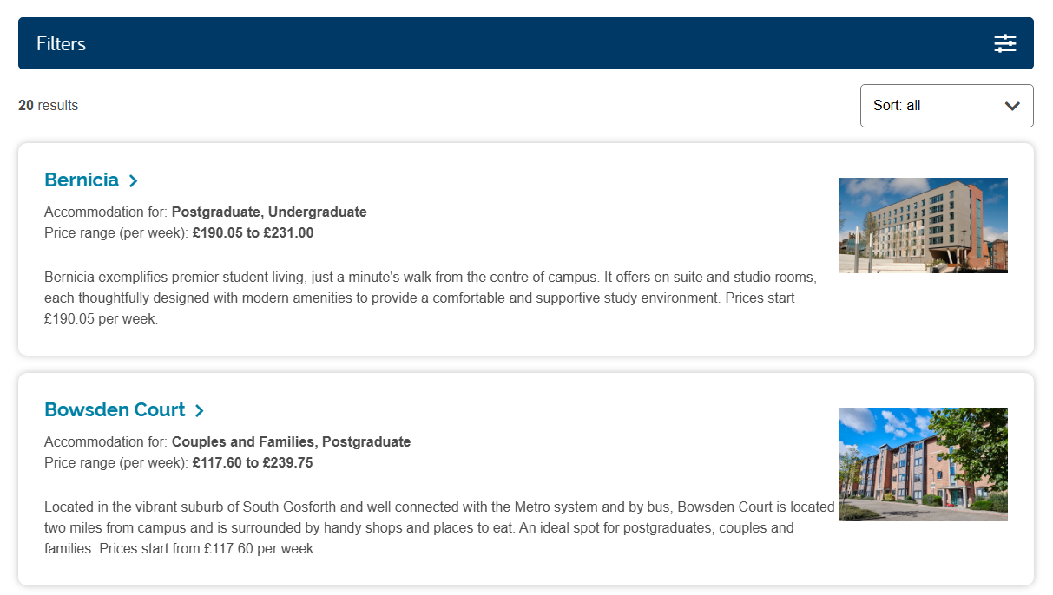
Accommodation
To be reserved after having accepted an offer (therefore, the firm choice).
Students need to do some budgeting before selecting the accommodation. The most expensive, (luxury, location, en-suite etc.), can easily exceed the maintenance loan.
Accommodation is normally guaranteed for first-year students.
Medicine, Veterinary Science, Dentistry, Oxbridge, Conservatoires

Slide 21
Student finance
TUITION FEE LOAN
The majority of undergraduate courses will charge £10,050 p/a. SFE will provide a loan to cover this. It goes straight to the university.
MAINTENANCE LOAN
Students are expected to pay their own cost of living: accommodation, food, travel, leisure etc. SFE provides a loan to cover this. It is means tested and is shown overleaf. SFE has an exact calculator for families to use.

Slide 22
Student finance
Household Income | Minimum Loan | Additional Income-Based Loan | Maximum Loan You Receive
£25,000 or less | £5,048 | £5,782 | £10,830 (Maximum)
£35,000 | £5,048 | £4,435 | £9,483
£45,000 | £5,048 | £2,691 | £7,739
£55,000 | £5,048 | £1,234 | £6,282
£62,410+ | £5,048 | £0 | £5,048 (Minimum)
Medicine, Veterinary Science, Dentistry, Oxbridge, Conservatoires

Slide 23
Student finance - repayment
Student loan repayments do not begin until the individual is earning above £25,000 p/a
After this, 9% of all income is made as a repayment through the PAYE system.
The loan will expire after 40 years
The outstanding balance is subject to interest of RPI only (currently 3.2%)
(Recent controversy has been for Type 2 loans where interest is RPI + 3%)
Medicine, Veterinary Science, Dentistry, Oxbridge, Conservatoires

Slide 24
The process
Students make up to five choices (except some early entrants)
Universities have deadlines by which to decide based on when the application was received
Students have decide-by-dates, based on when they received their last offer.
One offer is ‘firmed’ another may be ‘insured’.
If all offers are unsuccessful applicants may join Extra
If a students hold no offers on results day, they may enter Clearing
Medicine, Veterinary Science, Dentistry, Oxbridge, Conservatoires
Notes:
DBD pair 1 – all offers by 11th March – DBD April 6th
DBD pair 2 – all offers by 31st March – DBD May 5th
DBD pair 3 – all offers by 13th May – DBD June 2nd

Slide 25
Deferred entry – gap year
Students must check with their university if they will accept a deferred application. (If it is not mentioned on the website, then call the admissions department).
MES will support students to apply in a subsequent year, up to three years. They simply email me for that year’s buzzword and apply as a past student.

Slide 26
Contextual offers
If a student has faced a barrier to their learning, then a university may choose to make them a more generous offer. This is known as a contextual offer. This will likely involve further liaising with the university.
This will be known by information shared by the student in their application. Common criteria include:
Where you live – some universities may use postcode measures to see if you live in an area where there is a high level of deprivation, or a low number of people going to university.
Your school or college – if your school’s academic performance is lower than the national average, or a small number of pupils go on to higher education.
Household income – if your total household income is lower than average.
Parental education – if your parents did not attend university.
If you have spent time in local authority care, such as a foster home, residential children’s home or kinship care. Read more about going to university from a care background.
If you are estranged from your parents – if your relationship has broken down leading to no contact. Read more about going to university as an estranged student.
If you have caring responsibilities – those who are unpaid carers for a family member or friend. Read more about going to university as a carer.
If you have a disability or mental health condition – including learning differences and long-term health conditions. Read more about going to university as a disabled student.

Slide 27
Bursaries
Universities have their own bursary schemes. Students would be expected to apply themselves.
This may be a useful thing to research when selecting universities to apply for.
Medicine, Veterinary Science, Dentistry, Oxbridge, Conservatoires

Slide 28
Next steps
It is much easier to do the application on a laptop or desktop than a phone.
It can be saved in progress and returned to.
Students have received step-by-step instructions to complete all of the stages.
Once submitted, (before the MES internal deadline), with a £28.50 processing fee, the application comes to me to check everything, and students must log back into their account in case I send it back to them with an error that needs changing. Once returned and sent, students await their offers/decisions.
Medicine, Veterinary Science, Dentistry, Oxbridge, Conservatoires

Slide 29
Timeline for 2027 entry
Date | UCAS process for 2025 entry
NOW | Register on UCAS hub
28th April | UCAS 2026 courses in search tool
12th May | UCAS 2025 system live (not for MES students)
11th May | MES UCAS The process explained
2nd July | MES UCAS Application launch assembly
15th July | MES personal statements assembly
14th July | MES UCAS Parents Information Evening - 6.00pm
17th July | Future Pathways day - Personal Statement session
18th Sept | UCAS predicted grades to be published from this date
1st October | MES Early Entry deadline
15th October 18:00 | UCAS Early Entry deadline
4th January 2026 | MES UCAS deadline
13th January 2026 | UCAS Equal Consideration deadline
| 29

Slide 30
Next steps
Their will be a series of assemblies in Year 12/13 covering specifically personal statements, student finance, how to respond to offers and reminding students to apply for accommodation.
Medicine, Veterinary Science, Dentistry, Oxbridge, Conservatoires

Slide 31
Elephants in the room
Level of debt
Shrinking graduate vacancies
Lack of work experience
University still makes sense for many students, but it needs to be part of a well-thought through plan, much more than ever before.
Work experience and employability need to be considered much more than ever before.
Medicine, Veterinary Science, Dentistry, Oxbridge, Conservatoires

Slide 32
Any questions?
Please stay for a short Q and A
If you are ready to leave, please take a parental checklist on your way out that has my email address on it, just in case.
Medicine, Veterinary Science, Dentistry, Oxbridge, Conservatoires

